Slide 1
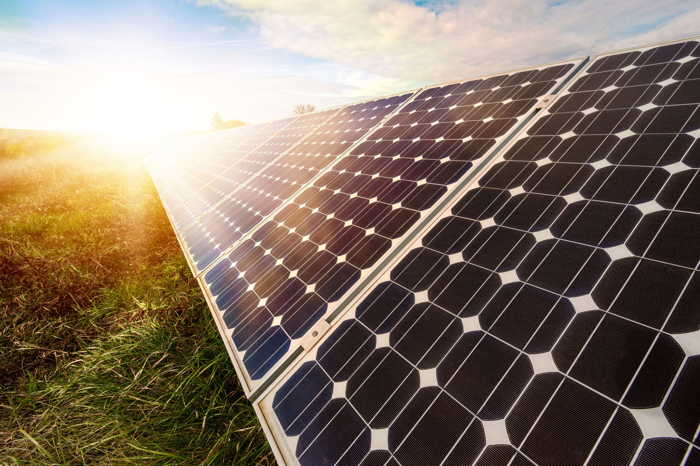
Solar-Powered Multi-Tasking
Agricultural Robot
By:-
V.Prashanthi-2310040003
M.Kaavya-2310040006
G.Abinaya-2310040009
G.Akshaya-2310040011

Slide 2
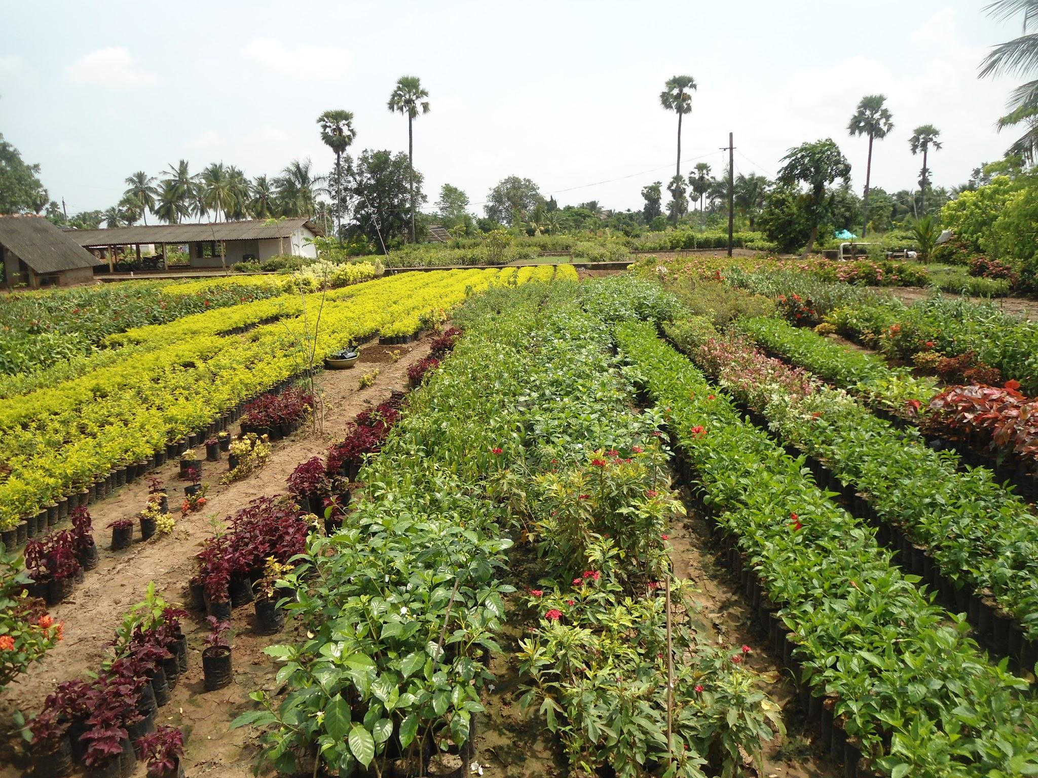
Problem Statement
Urban and small-scale farmers often face challenges in managing repetitive tasks such as seed sowing, watering, and soil covering due to limited labor, time, and access to automation tools. These manual processes reduce efficiency and hinder the adoption of smart, sustainable farming practices in compact and nursery-scale environments.
Goal
To create a compact, user-friendly robot for home farming and nurseries that automates these basic but crucial tasks.
Vision
To empower individuals and small growers with smart farming tools—starting with nurseries and home gardens, and scaling up to larger farms in the future.

Slide 3
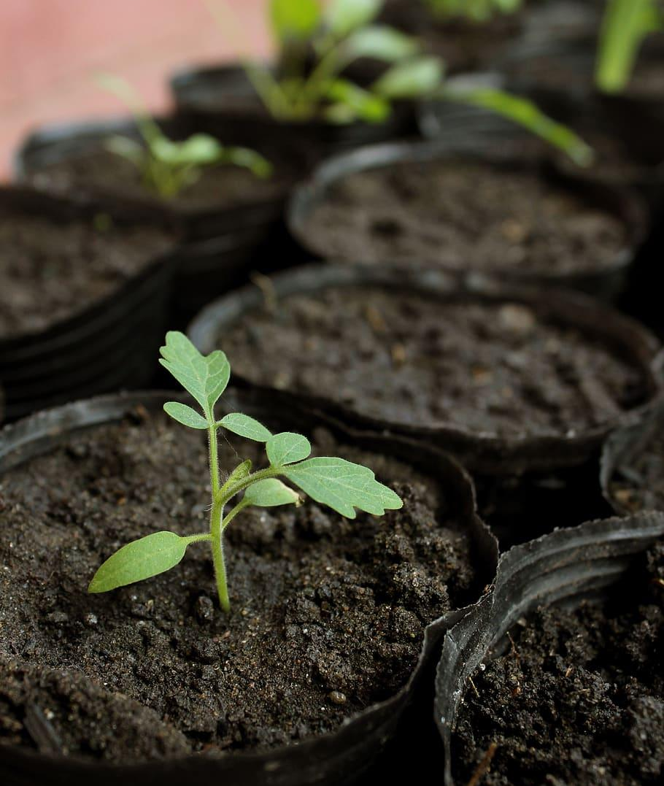
Problems Faced by Small Growers
- Labor shortage for daily tasks
- Time-consuming manual processes
- Inefficient use of water/seeds
- Lack of affordable automation options
- Need for compact tools in limited spaces

Slide 4
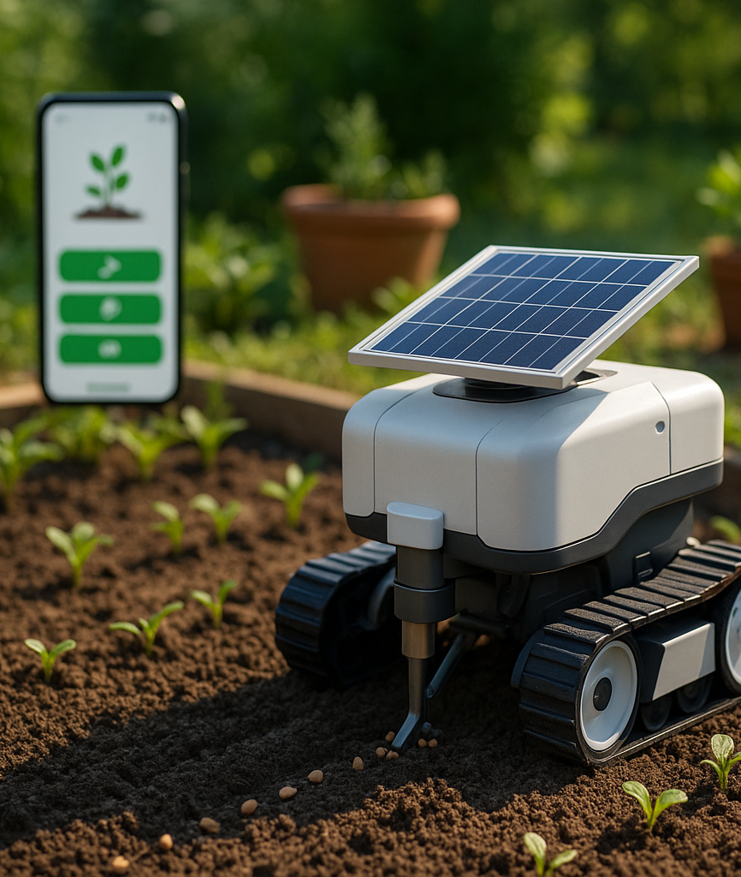
Project Objectives
Develop an automated system for seed sowing, watering, and soil covering.
Design a solar-powered robot optimized for outdoor nursery and garden use.
Ensure a compact form factor with user-friendly operation in limited spaces.
Incorporate Bluetooth connectivity for manual control via a mobile app.
Enable a modular architecture to support future feature expansion and scalability.

Slide 5
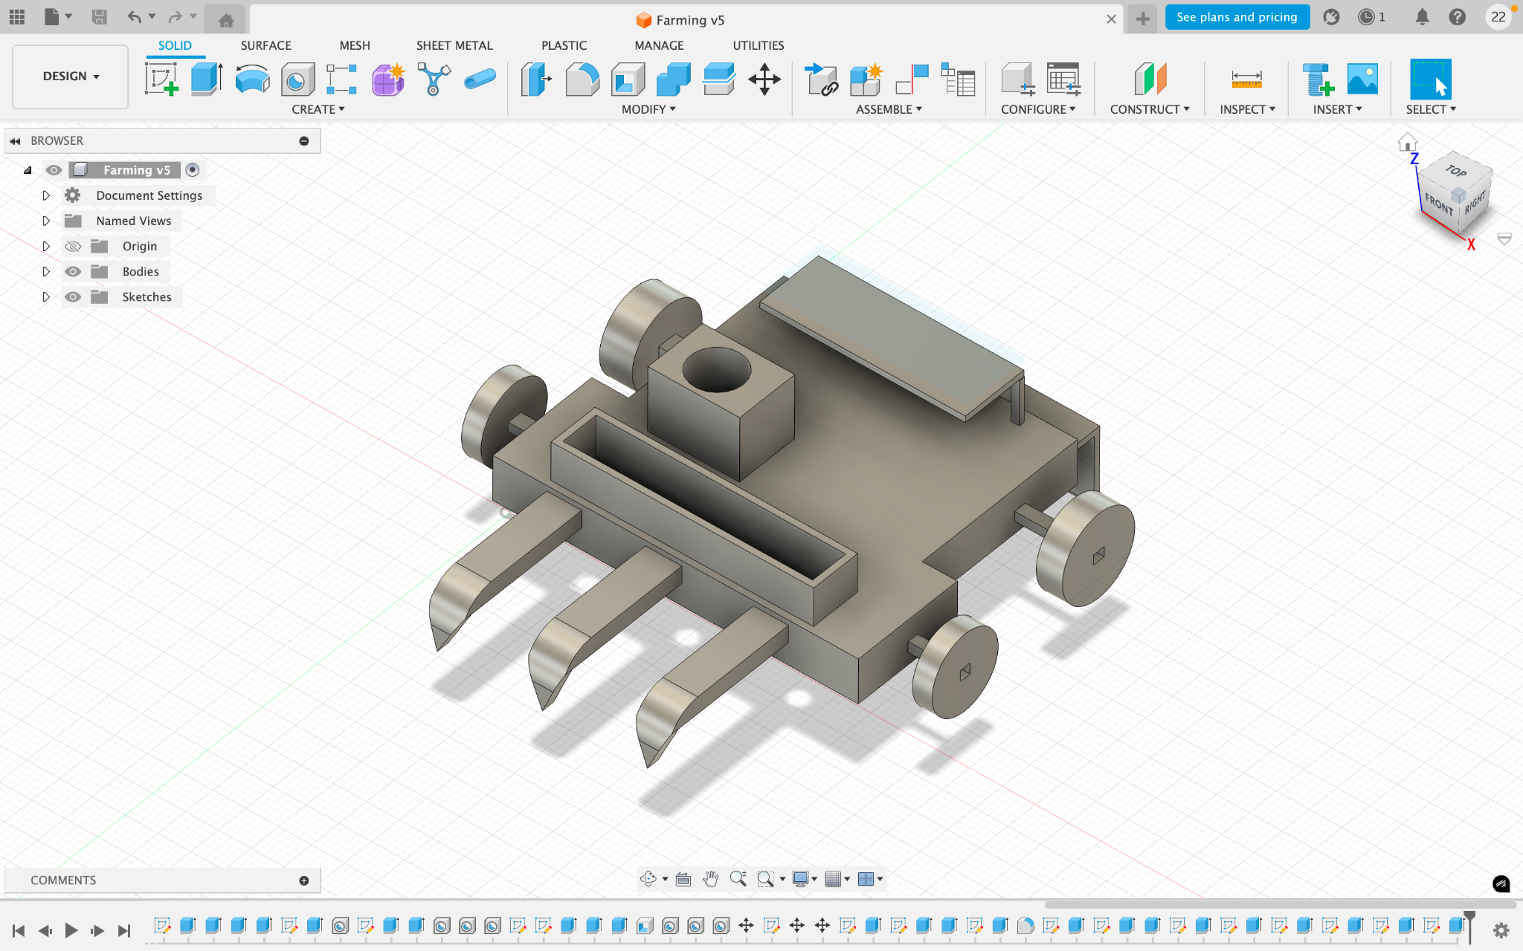
Our Solar-Powered Agricultural Robot
Specifically built for nurseries and home garden applications
Powered by solar energy for sustainable, off-grid operation
Automates key farming tasks: • Precision seed sowing • Soil covering after planting • Basic weeding and soil loosening
Compact and lightweight design for easy maneuverability
Supports manual control via a Bluetooth-enabled mobile app

Slide 6
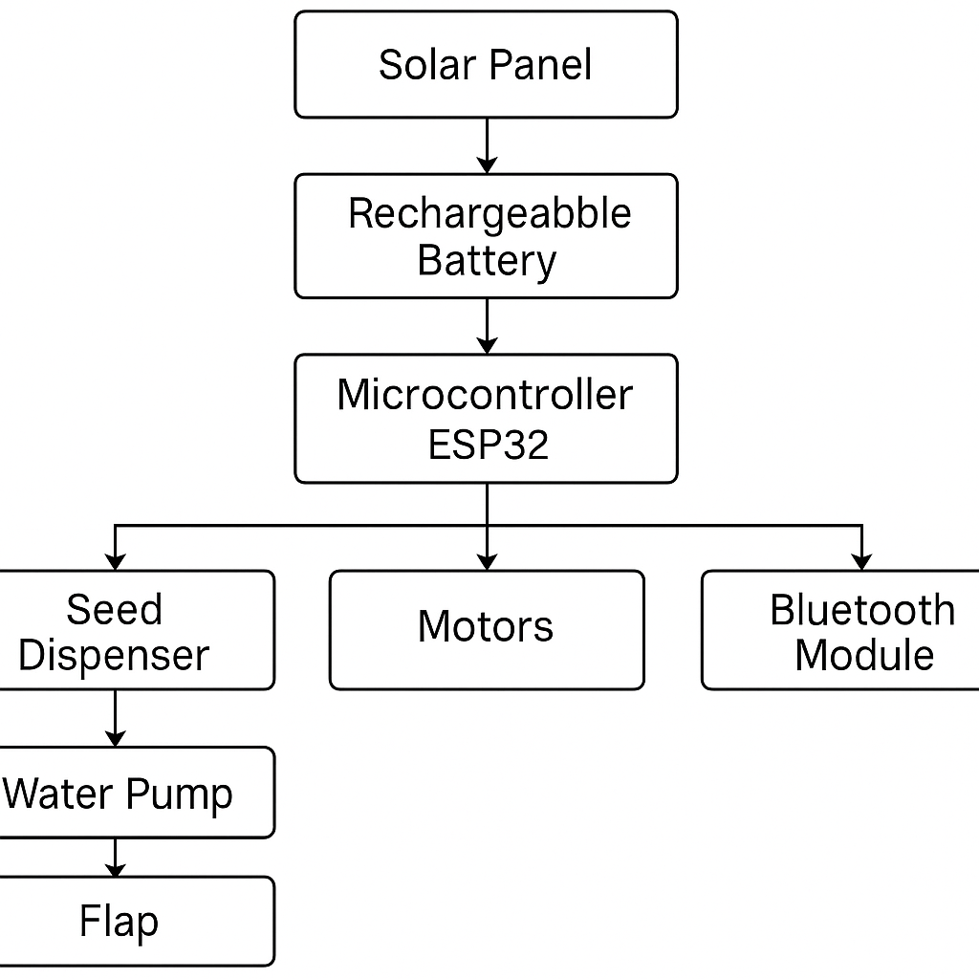
Hardware Components & Their Roles
ESP32 – Central controller with Bluetooth (mounted on chassis)
Solar Panel + Battery – Power source (top of robot)
DC Motors (x2) – For wheel movement (left & right sides)
L298N Driver – Controls DC motors
Stepper Motor – Drives seed dispenser (front center)
Mini Water Pump – Waters soil after seeding (side/rear)
Servo Motor – Controls soil-covering flap (rear underside)
Soil Moisture Sensor – Measures soil wetness (near sowing area)
Ultrasonic Sensor – Detects obstacles (front)
Chassis – Base frame holding all components
GSM Module (SIM800L) – Enables remote control and SMS-based
monitoring in areas without Wifi.

Slide 7
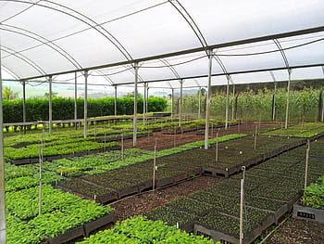
Impact and Future Scope
Simplifies farming activities for home gardeners and nursery owners
Enhances efficiency by saving time, labor, and water
Scalable design allows adaptation for larger agricultural applications
Expandable with additional modules (e.g., fertilizer sprayer,
advanced sensors, automation)
Supports the broader vision of smart, sustainable, and tech-driven
farming

Slide 8

Thank You

